Slide 1
Automation Tool: Logistic Regression
Brief Overview

Slide 2
Overview
Objective: End to End automation for building best possible Logistic Regression Models.
Inputs to Tool:
Dataset with raw variables and Business/Derived variables if any (e.g. ratio of balance to payment, ratio of balance 1 month/balance average 3 month etc.
A list of variables that can be used in the model
Architecture:
Thin Client Approach – Front end GUI which talks to SAS server at the backend
Plan to port code base to R and other platforms

Slide 3
Algorithm
Modified Genetic Algorithm for convergence
Three Step Approach:
Variable derivation: Automated WOE and Indicator transformation against each variable.
Variable Selection: Each variable is ranked against other variables based on more than 30 attributes (IV, p-value, KS etc. along with other custom attributes) using proprietary ranking mechanism.
Convergence: This is achieved through applying a variant of above ranking mechanism (for a group of variables) to iteratively converge to best possible group.

Slide 4
Results
Tool has been tested on synthetic as well as real life datasets from banking industry* and in all cases it either
Defeats the manually created models or
Gives similar performing models
*unofficial testing - Test code was given to our colleagues in few companies and they reported back the results to us

Slide 5
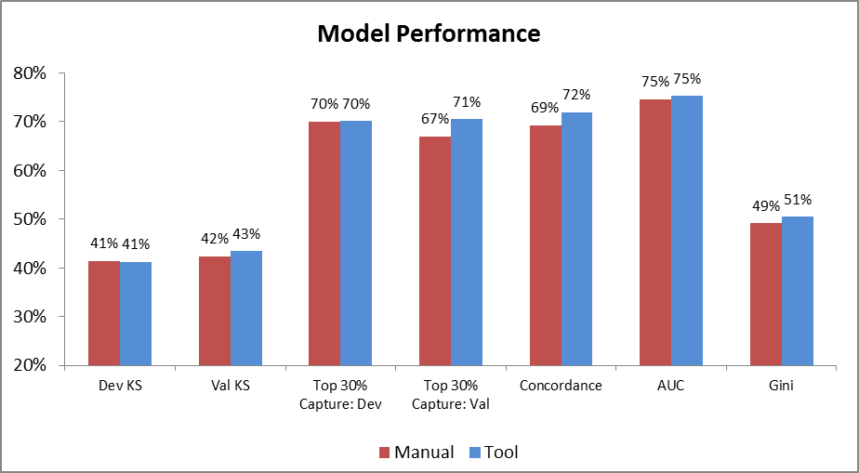
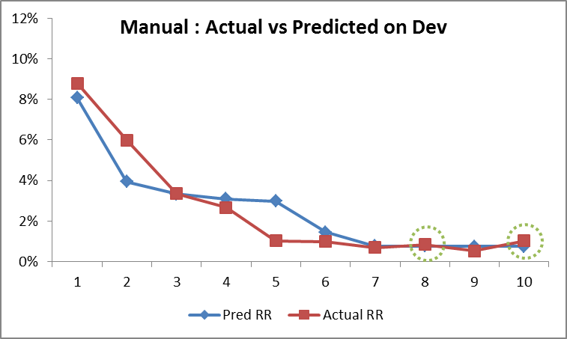
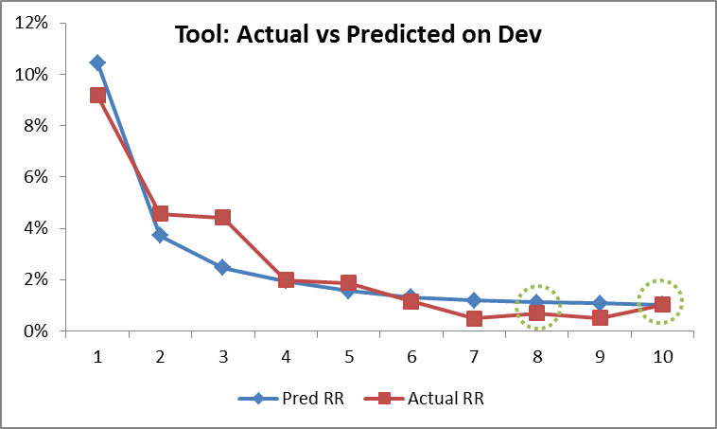
Result - 1
Observations | Event Rate | # Variables | Time Taken - Manual | Time Taken - Tool
~5K | ~2.15% | 182 | 1+ Week | 1.15 hours

Slide 6
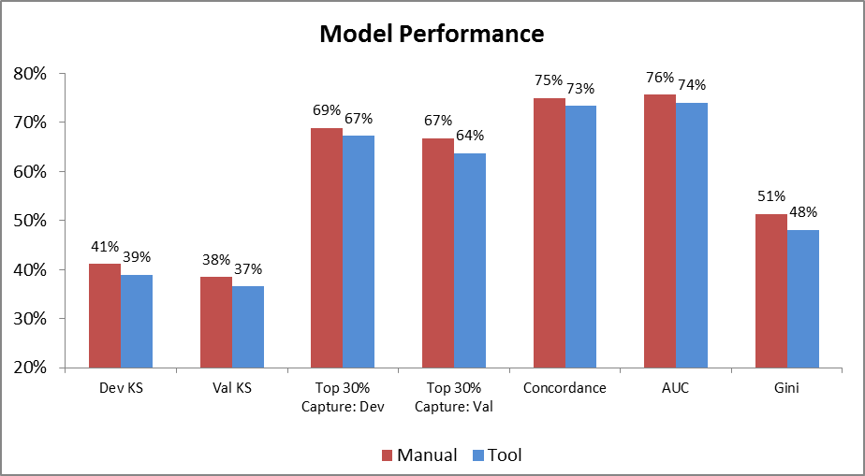
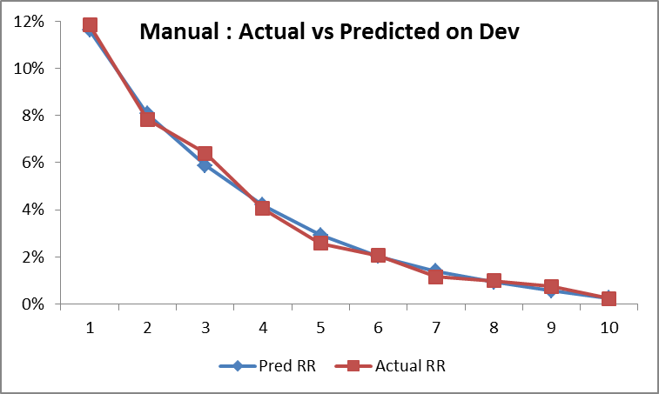
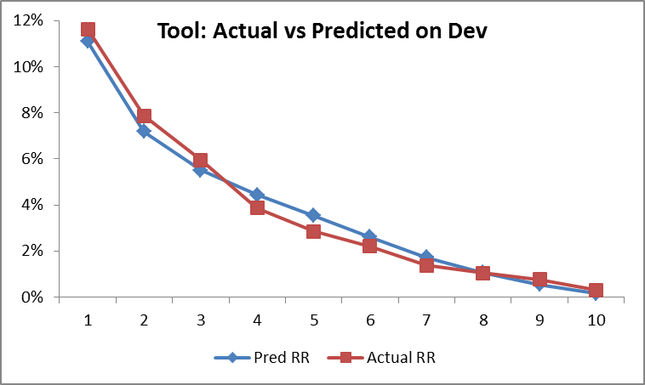
Result - 2
Observations | Event Rate | # Variables | Time Taken - Manual | Time Taken - Tool
~50K | ~4% | 73 | 2+ Week | 2 hours

